Slide 1

Overview of .NET
Prof. Dr. Hanspeter Mössenböck
Institute for System Software
Johannes Kepler University Linz
© University of Linz, Institute for System Software, 2004
published under the Microsoft Curriculum License

Slide 2
What is .NET?
A new software platform for the desktop and the Web
Unmanaged
Applications
Operating System (Windows, Linux, Unix, ...)

Slide 3
What is .NET?
A new software platform for the desktop and the Web
Unmanaged
Applications
Managed Applications
Class Library
Common Language Runtime
Operating System (Windows, Linux, Unix, ...)
Common Language
Runtime
interoperability, security, garbage collection, versioning, ...
Class Library
GUI, collections, threads, networking, reflection, XML, ...

Slide 4
What is .NET?
A new software platform for the desktop and the Web
Unmanaged
Applications
Managed Applications
Web Applications
Web Forms
Web Services
Class Library
ASP.NET
Common Language Runtime
Web Server (IIS)
Operating System (Windows, Linux, Unix, ...)
ASP.NET,
Web Forms
Web GUI (object-oriented, event-based, browser-independent)
Web Services
distributed services over RPC (SOAP, HTTP)

Slide 5
What is .NET?
A framework and more ...
Unmanaged
Applications
Managed Applications
Web Applications
Web Forms
Web Services
Class Library
ASP.NET
Common Language Runtime
Web Server (IIS)
Operating System (Windows, Linux, Unix, ...)
.NET Framework
+ Tools (Visual Studio .NET, ildasm, gacutil, ...)
+ Servers (SQL Server, BizTalk Server, ExchangeServer, ...)
+ Services (My Service, Passport Service, ...)

Slide 6
Goals of .NET
Uniform model for desktop and Web programming
So far
Desktop programming
Web programming
object-oriented
compiled (C/C++, Fortran, ...)
extensive class libraries
ASP (not object-oriented)
interpreted (VBScript, Javascript, PHP, ...)
specialized libraries
Under .NET
Desktop and Web programming
object-oriented (even ASP.NET)
compiled (C#, C++, VB.NET, Fortran, ...)
uniform class library

Slide 7
Goals of .NET
Interoperability between programming languages
So far
  - millions of lines of code in C++, Fortran, Visual Basic, ...
  - very limited interoperability
Under .NET
  binary compatibility between more than 20 languges (C#, C++, VB.NET, Java,
  Eiffel, Fortran, Cobol, ML, Haskell, Pascal, Oberon, Perl, Python, ...)
class in VB.NET
subclass in C#
used in Eiffel
Public Class A
Public x As Integer
Public Sub Foo() ...
End Class
class B : A {
public string s;
public void Bar() {...}
}
class Client feature
obj: B;
...
create obj;
obj.Bar;
...
end

Slide 8
Goals of .NET
Web Services: distributed applications on the Internet
Usage of the Internet so far
  - Email
  - Web browser (presents data to human users)
Under .NET: B2B applications without a Web browser
tourist office
airline
Hotel "Sunny Island"
hotel chain
bank
Hotel "Blue Moon"
Based on simple standards
HTTP
SOAP (XML)
remote procedure call

Slide 9
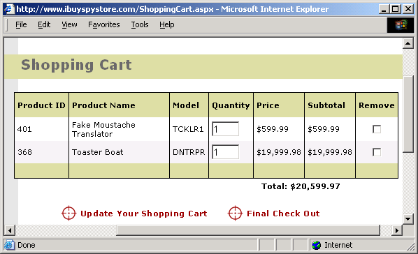
Goals of .NET
Simpler programming of dynamic Web pages
So far
  - ASP (mixture of HTML and VBScript or Javascript)
Under .NET
  - ASP.NET (clean separation of HTML and script code)
object-oriented
event-based
rapid application development (RAD)
allows user-written GUI elements
efficient (compiled server scripts)
automatic state management
authorisation / authentication
...

Slide 10
Goals of .NET
More quality and convenience
- Security
strong static typing
run-time type checks (no more buffer overruns!)
garbage collection
CIL code verifier
public key signatures of code
role-based access rights
code-based access rights
- Side by Side Execution
versioning
end of "DLL hell"
- Simpler Software Installation
no more registry entries
clean and simple de-installation

Slide 11
Interoperability
C#
C#
C++
VB
...
if (a > b) max = a; else max = b;
CIL
compiler
compiler
compiler
compiler
IL_0004: ldloc.0
IL_0005: ldloc.1
IL_0006: ble.s IL_000c
IL_0008: ldloc.0
IL_0009: stloc.2
IL_000a: br.s IL_000e
IL_000c: ldloc.1
IL_000d: stloc.2
CIL code
(+ metadata)
loader
Intel code
verifier
mov ebx,[-4]
mov edx,[-8]
cmp ebx,edx
jle 17
mov ebx,[-4]
mov [-12],ebx
...
JIT compiler
machine code

Slide 12
Assemblies
Prog.cs
Lib.cs
Assemblies are the smallest unit for
deployment
versioning
dynamic loading
class A { ... }
class B { ... }
class C { ... }
csc Prog.cs,Lib.cs
Prog.exe
version number
public key
interface description of
- classes
- methods
- variables
- parameters
- types
- ...
manifest
metadata is used for:
- dynamic loading
- versioning
- reflection
metadata
CIL code of A
CIL code of B
CIL code of C
loader

Slide 13
Literature
C#
H.Mössenböck: C# to the Point. Addison-Wesley, 2005
H.Mössenböck: Softwareentwicklung mit C#. dpunkt.verlag, 2006
Hejlsberg, Wiltamuth, Golde: The C# Programming Language, Addison-Wesley, 2004
B.Albahari, P.Drayton, B.Merrill: C# Essentials. O'Reilly, 2001
Microsoft: C# Language Specification. Microsoft Press, 2001
S.Robinson et al: Professional C#, Wrox Press, 2001
.NET
Mössenböck, Beer, Birngruber, Wöß:.NET Application Development. Addison-W., 2004
Beer, Birngruber, Mössenböck, Prähofer, Wöß: Die .NET-Technologie, dpunkt.verlag 2006
J.Gough: Compiling for the .NET Common Language Runtime. Prentice Hall, 2002
J. Richter: Applied Microsoft .NET Framework Programming. Microsoft Press, 2002
Web Sites
msdn.microsoft.com/netframework/
www.gotdotnet.com
www.devhood.com
www.asp.net
dotnet.jku.at
Reference information and tutorials in the .NET SDK

